Slide 1
Photorealistic Rendering of Training Data for Object Detection and Pose Estimation with a Physics Engine Presented by Alexander Epple Supervised by Fabian Manhardt Johanna Wald Advisor Prof. Nassir Navab TUM department of informatics Chair for Computer Aided Medical Procedures & Augmented Reality Kick off Bachelor thesis

Slide 2
Introduction

Slide 3
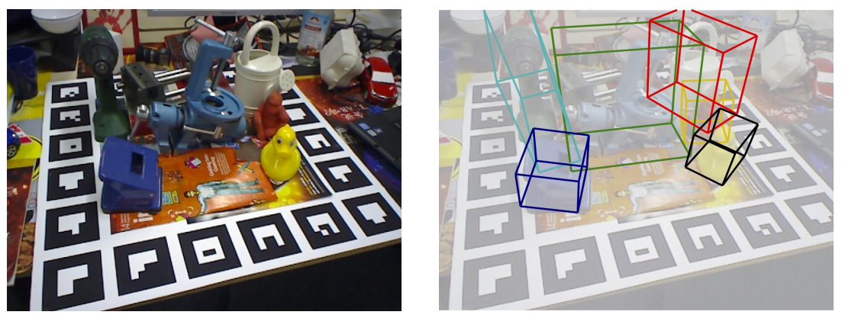
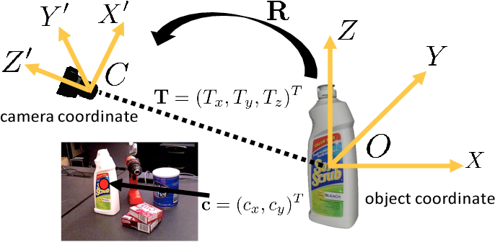
Introduction: Pose estimation
Problem in computer vision: Estimation of 3D information from 2D data
Input: RGB (+ optionally depth) image
Output: 6 DOF pose (rotation, translation) of objects in scene
Tekin, B., Sinha, S.N. and Fua, P., 2018. Real-time seamless single shot 6d object pose prediction. Proceedings of the IEEE Conference on Computer Vision and Pattern Recognition (pp. 292-301).
Xiang, Y., Schmidt, T., Narayanan, V. and Fox, D., 2017. PoseCNN: A Convolutional Neural Network for 6D Object Pose Estimation in Cluttered Scenes. Robotics: Science and System XIV.

Slide 4
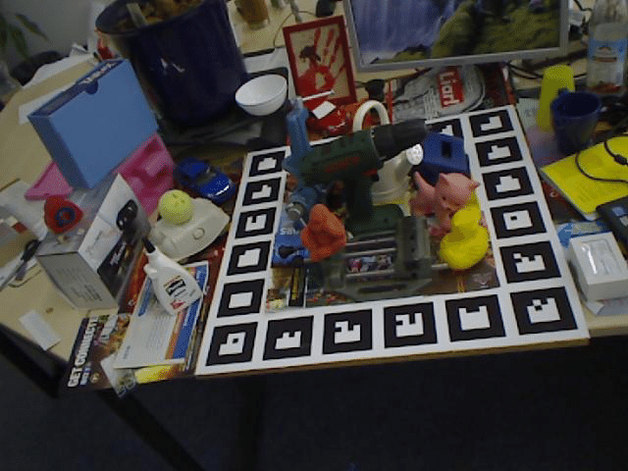
Pose estimation: Real training data
Examples
Xiang, Y., Schmidt, T., Narayanan, V. and Fox, D., 2017. PoseCNN: A Convolutional Neural Network for 6D Object Pose Estimation in Cluttered Scenes. Robotics: Science and System XIV.
Peng, S., Liu, Y., Huang, Q., Zhou, X. and Bao, H., 2019. Pvnet: Pixel-wise voting network for 6dof pose estimation. Proceedings of the IEEE Conference on Computer Vision and Pattern Recognition (pp. 4561-4570).
Hinterstoisser, S., Lepetit, V., Ilic, S., Holzer, S., Bradski, G., Konolige, K. and Navab, N., 2012. Model based training, detection and pose estimation of texture-less 3d objects in heavily cluttered scenes. Asian conference on computer vision (pp. 548-562).

Slide 5
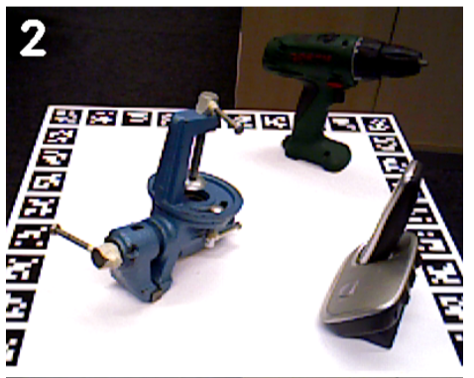
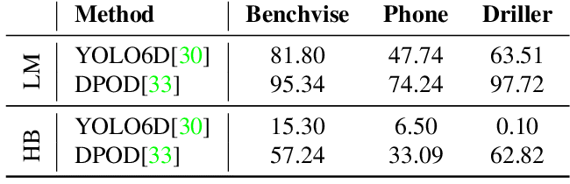
Pose estimation: Real training data
Problems
Not many datasets available
Hard to acquire & annotate manually
Lots of training data needed for pose estimation
Can lead to overfitting
HomebrewedDB (HB) vs LineMOD (LM)
Kaskman, R., Zakharov, S., Shugurov, I. and Ilic, S., 2019. Homebreweddb: Rgb-d dataset for 6d pose estimation of 3d objects. Proceedings of the IEEE International Conference on Computer Vision Workshops

Slide 6
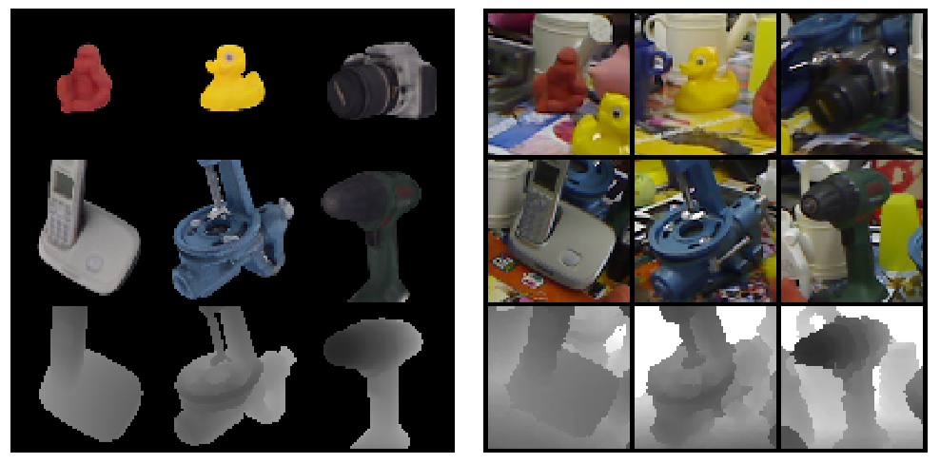
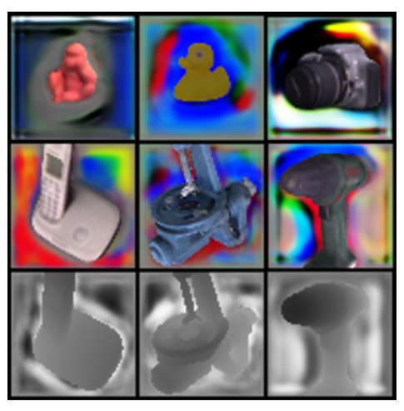
Solution: Synthetic training data
Advantages
Easy to obtain accurate training data
Inexpensive and fast
Problems
Domain gap between real / synthetic images
Poor performance with real data due to overfitting
Hard to generalize without additional techniques
Zakharov, S., Kehl, W. and Ilic, S., 2019. Deceptionnet: Network-driven domain randomization. Proceedings of the IEEE International Conference on Computer Vision (pp. 532-541).

Slide 7
Related Work

Slide 8
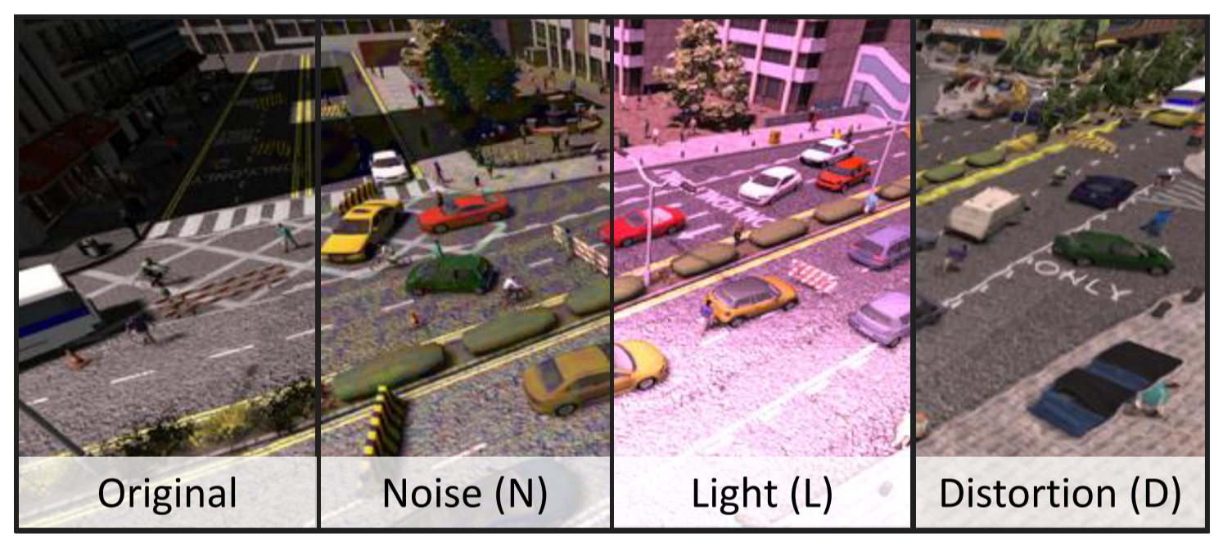
Domain Randomization
Examples
Zakharov, S., Kehl, W. and Ilic, S., 2019. Deceptionnet: Network-driven domain randomization. Proceedings of the IEEE International Conference on Computer Vision (pp. 532-541).
Tobin, J., Fong, R., Ray, A., Schneider, J., Zaremba, W. and Abbeel, P., 2017. Domain randomization for transferring deep neural networks from simulation to the real world. 2017 IEEE/RSJ International Conference on Intelligent Robots and Systems (IROS) (pp. 23-30).
Zakharov, S., Kehl, W. and Ilic, S., 2019. Deceptionnet: Network-driven domain randomization. Proceedings of the IEEE International Conference on Computer Vision (pp. 532-541).

Slide 9
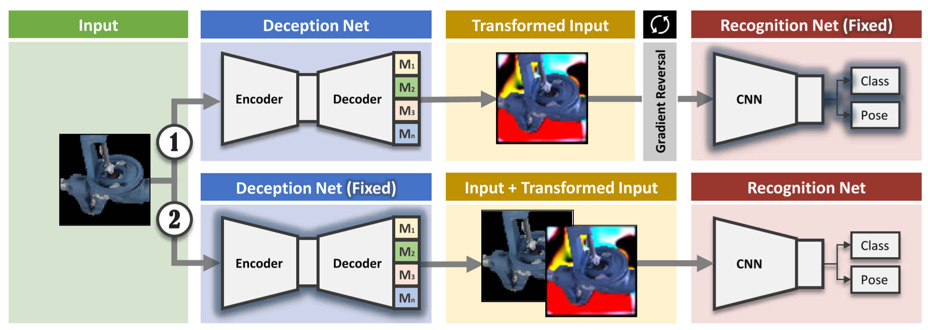
DeceptionNet: Training
Zakharov, S., Kehl, W. and Ilic, S., 2019. Deceptionnet: Network-driven domain randomization. Proceedings of the IEEE International Conference on Computer Vision (pp. 532-541).

Slide 10
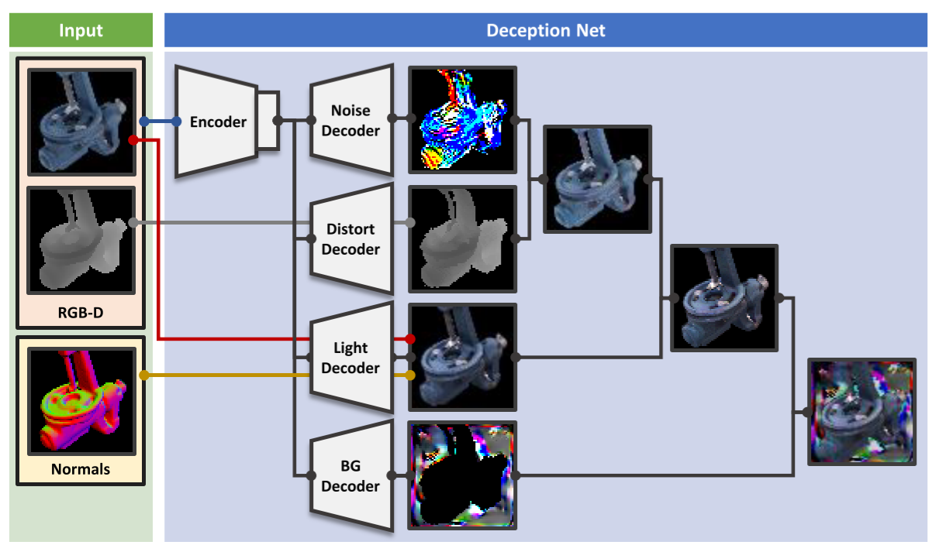
DeceptionNet: Input augmentation
Zakharov, S., Kehl, W. and Ilic, S., 2019. Deceptionnet: Network-driven domain randomization. Proceedings of the IEEE International Conference on Computer Vision (pp. 532-541).

Slide 11
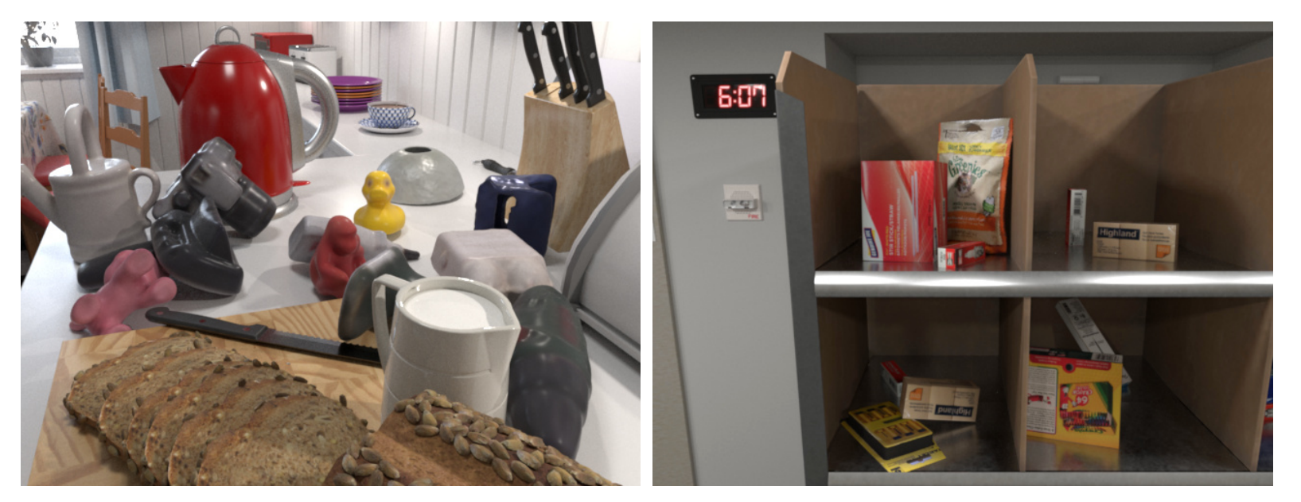
Photorealistic Rendering
Examples:
Hodaň, T., Vineet, V., Gal, R., Shalev, E., Hanzelka, J., Connell, T., Urbina, P., Sinha, S.N. and Guenter, B., 2019. Photorealistic image synthesis for object instance detection. 2019 IEEE International Conference on Image Processing (ICIP) (pp. 66-70).
Tremblay, J., To, T. and Birchfield, S., 2018. Falling things: A synthetic dataset for 3d object detection and pose estimation. Proceedings of the IEEE Conference on Computer Vision and Pattern Recognition Workshops (pp. 2038-2041).
Hodaň, T., Vineet, V., Gal, R., Shalev, E., Hanzelka, J., Connell, T., Urbina, P., Sinha, S.N. and Guenter, B., 2019. Photorealistic image synthesis for object instance detection. 2019 IEEE International Conference on Image Processing (ICIP) (pp. 66-70).

Slide 12
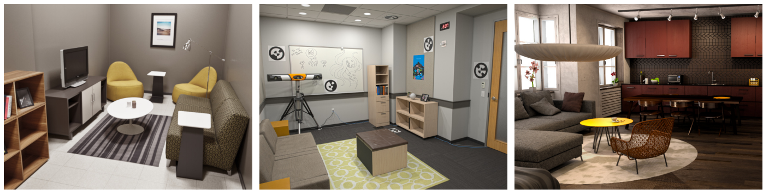
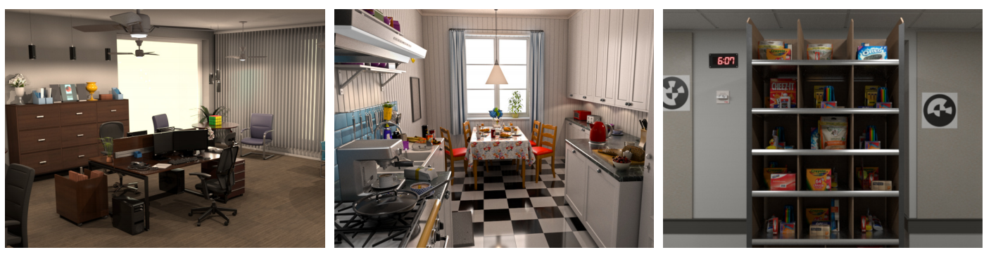
Photorealistic Image Synthesis for Object Instance Detection.
Approach
High definition meshes of 15 objects and 6 scenes.
Arranging objects physically plausible using Nvidia PhysX
Raytraced, physically based rendering (PBR) using Arnold Renderer
Hodaň, T., Vineet, V., Gal, R., Shalev, E., Hanzelka, J., Connell, T., Urbina, P., Sinha, S.N. and Guenter, B., 2019. Photorealistic image synthesis for object instance detection. 2019 IEEE International Conference on Image Processing (ICIP) (pp. 66-70).

Slide 13
Our Approach: Comparison
Similarities
Physically plausible poses using Nvidia PhysX
Synthetic, PBR objects using Blender & Appleseed renderer
Differences
Scene is not rendered, just objects
Objects are blended into existing, real images
Composed images are improved using harmonization

Slide 14
Our Approach: Discussion
Advantages
Minimizing the domain gap by using real images as baseline
Lower computational cost & faster rendering per frame by not rendering the scene
Challenges
Replicating illumination & conditions in real scene
Accurately reproducing camera pose & parameters to match real image
Integrating the scene’s physical & geometrical properties without rendering it

Slide 15
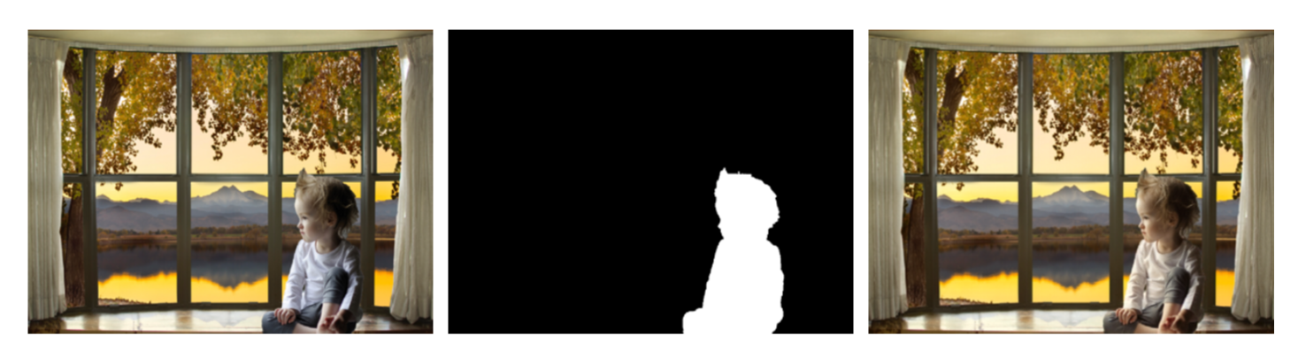
Outlook: Improving Image Quality
Examples:
Tsai, Y.H., Shen, X., Lin, Z., Sunkavalli, K., Lu, X. and Yang, M.H., 2017. Deep image harmonization. Proceedings of the IEEE Conference on Computer Vision and Pattern Recognition (pp. 3789-3797).
LeGendre, C., Ma, W.C., Fyffe, G., Flynn, J., Charbonnel, L., Busch, J. and Debevec, P., 2019. Deeplight: Learning illumination for unconstrained mobile mixed reality. Proceedings of the IEEE Conference on Computer Vision and Pattern Recognition (pp. 5918-5928).
Tsai, Y.H., Shen, X., Lin, Z., Sunkavalli, K., Lu, X. and Yang, M.H., 2017. Deep image harmonization. Proceedings of the IEEE Conference on Computer Vision and Pattern Recognition (pp. 3789-3797).

Slide 16
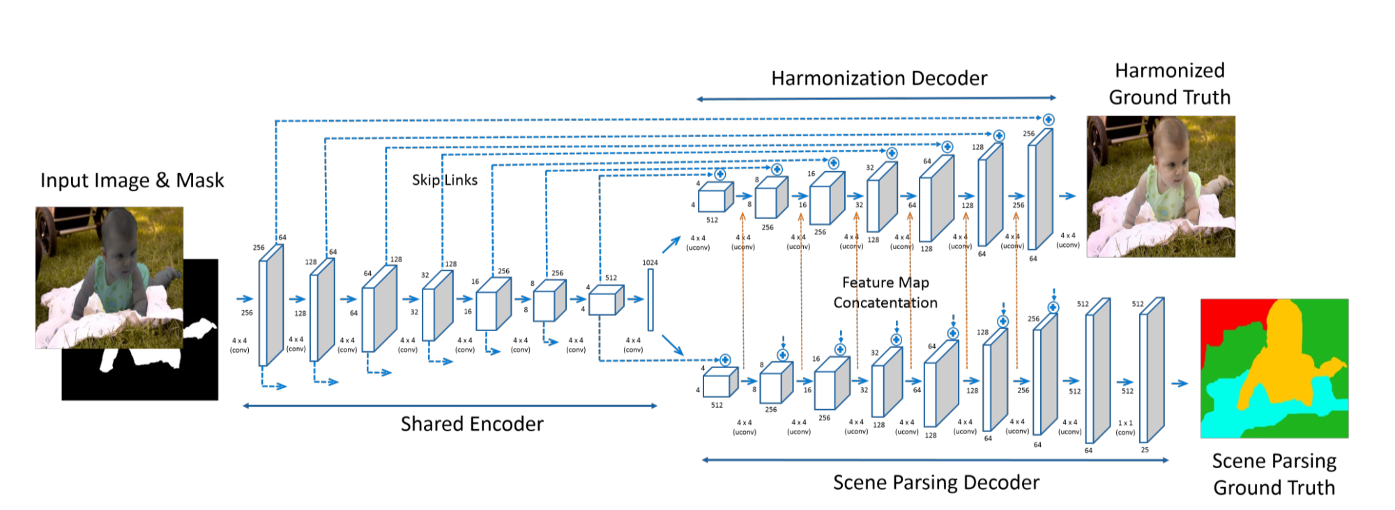
Deep Image Harmonization
Tsai, Y.H., Shen, X., Lin, Z., Sunkavalli, K., Lu, X. and Yang, M.H., 2017. Deep image harmonization. Proceedings of the IEEE Conference on Computer Vision and Pattern Recognition (pp. 3789-3797).

Slide 17
First Results

Slide 20



Slide 21
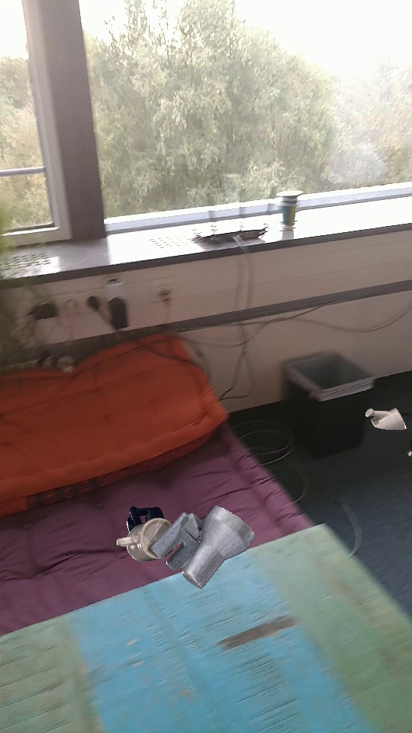
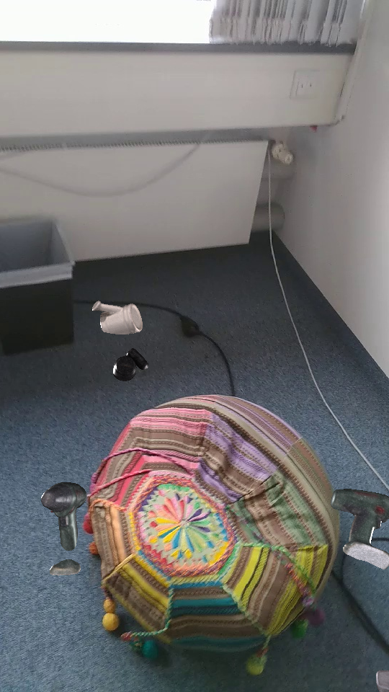

Slide 22



